Slide 1
Regularization
The problem of overfitting
Some slides taken from Andrew Ng’s Machine Learning course https://www.coursera.org/learn/machine-learning

Slide 2

1770

Slide 3
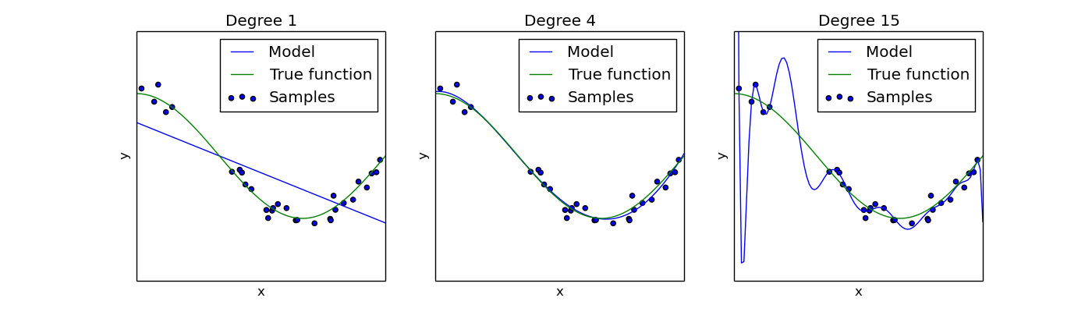

Underfitting vs. Overfitting (Linear Regression)
$$h_{w}\left(x\right)=w_{0}+w_{1}x$$
$$h_{w}\left(x\right)=w_{0}+w_{1}x+{w_{2}x}^{2}+{w_{3}x}^{3}+{w_{4}x}^{4}$$
$$h_{w}\left(x\right)=w_{0}+w_{1}x+{w_{2}x}^{2}+…+{w_{15}x}^{15}$$
Python source code : https://scikit-learn.org/0.15/auto_examples/plot_underfitting_overfitting.html

Slide 4
Generalization, Overfitting, Underfitting.
Generalization is the model’s ability to give sensible outputs to sets of input that it has never seen before.
Overfitting is the case where the overall cost is really small, but the generalization of the model is unreliable. This is due to the model learning “too much” from the training data set.
Underfitting is the case where the model has “ not learned enough” from the training data, resulting in low generalization and unreliable predictions.
https://towardsdatascience.com/what-are-overfitting-and-underfitting-in-machine-learning-a96b30864690

Slide 5



Example: Logistic regression
x₂
x₂
x₂
x₁
x₁
x₁
$$h_{w}\left(x\right)=σ\left(w_{0}+w_{1}x_{1}\right)$$
$$h_{w}\left(x\right)=σ\left(\begin{aligned}w_{0}+w_{1}x_{1}+w_{2}x_{2}+ \\ +{w_{3}x}_{1}^{2}+{w_{4}x}_{2}^{2}+w_{5}x_{1}x_{2}\end{aligned}\right)$$
$$h_{w}\left(x\right)=σ\left(\begin{aligned}w_{0}+w_{1}x_{1}+w_{2}x_{2}+ \\ +{w_{3}x}_{1}^{2}+{w_{4}x}_{2}^{2}+w_{5}x_{1}x_{2}+…\end{aligned}\right)$$
“Underfit”
“Overfit”
Overfitting: If we have too many features, the learned hypothesis may fit the training set very well (J(w)≈0 ), but fail to generalize to new examples.

Slide 6
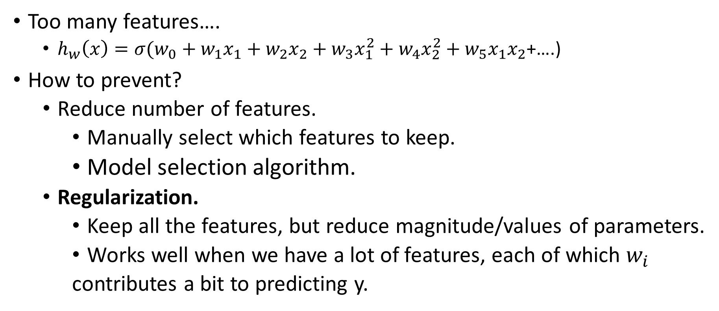
Why overfitting?
Too many features….
$h_{w}\left(x\right)=σ(w_{0}+w_{1}x_{1}+w_{2}x_{2}+{w_{3}x}_{1}^{2}+{w_{4}x}_{2}^{2}+w_{5}x_{1}x_{2}$+….)
How to prevent?
Reduce number of features.
Manually select which features to keep.
Model selection algorithm.
Regularization.
Keep all the features, but reduce magnitude/values of parameters.
Works well when we have a lot of features, each of which $w_{i}$
contributes a bit to predicting y.

Slide 7
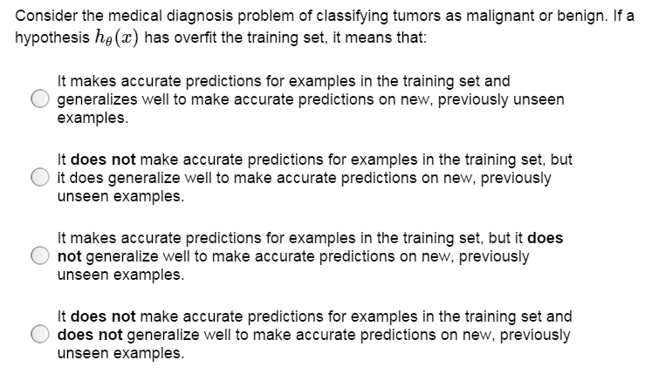

Slide 8
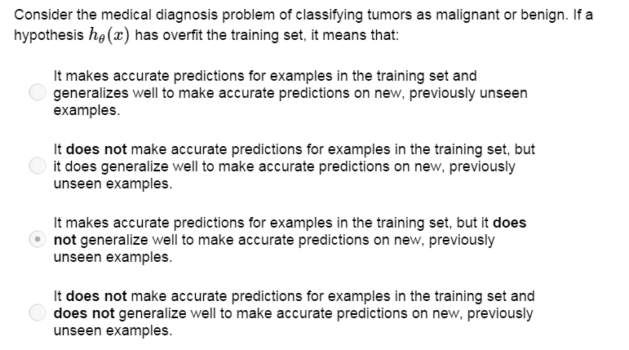

Slide 9
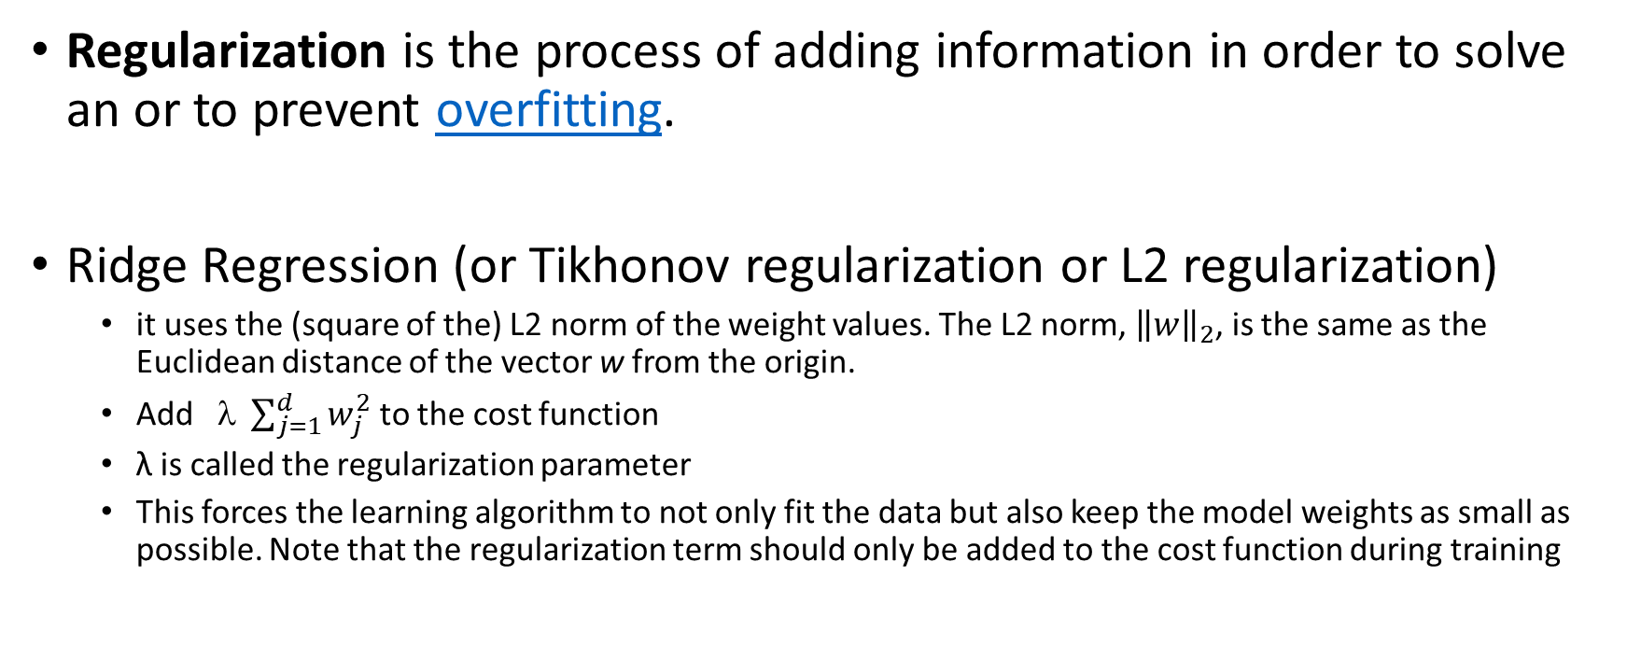
Regularization
Regularization is the process of adding information in order to solve an or to prevent overfitting.
Ridge Regression (or Tikhonov regularization or L2 regularization)
it uses the (square of the) L2 norm of the weight values. The L2 norm, ${\left\|w\right\|}_{2}$, is the same as the Euclidean distance of the vector w from the origin.
Add $ \sum_{j=1}^{d}{w_{j}^{2}}$ to the cost function
λ is called the regularization parameter
This forces the learning algorithm to not only fit the data but also keep the model weights as small as possible. Note that the regularization term should only be added to the cost function during training
https://en.wikipedia.org/wiki/Regularization_(mathematics)

Slide 10
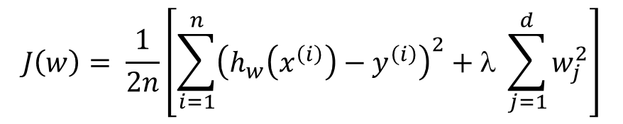
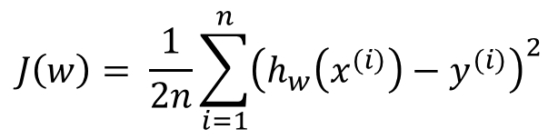
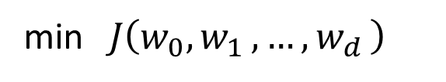
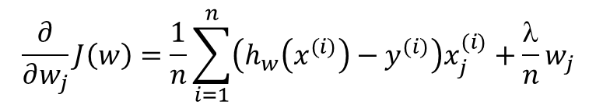
Regularized linear regression
$$J\left(w\right)= \frac{1}{2n}\sum_{i=1}^{n}{{\left(h_{w}\left(x^{(i)}\right)−y^{(i)}\right)}^{2}}$$
Cost Function:
$$J\left(w\right)= \frac{1}{2n}\left[\sum_{i=1}^{n}{{\left(h_{w}\left(x^{\left(i\right)}\right)−y^{\left(i\right)}\right)}^{2}}+λ \sum_{j=1}^{d}{w_{j}^{2}}\right]$$
Regularized Cost Function:
Goal:
min$J\left(w_{0}{,w}_{1}{,…,w}_{d}\right)$
w
$$\frac{∂}{∂w_{j}}J\left(w\right)=\frac{1}{n}\sum_{i=1}^{n}{\left(h_{w}\left(x^{(i)}\right)−y^{(i)}\right)x_{j}^{(i)}}+\frac{λ}{n}w_{j}$$
Derivative of cost function:
https://scikit-learn.org/stable/modules/generated/sklearn.linear_model.Ridge.html#sklearn.linear_model.Ridge

Slide 11
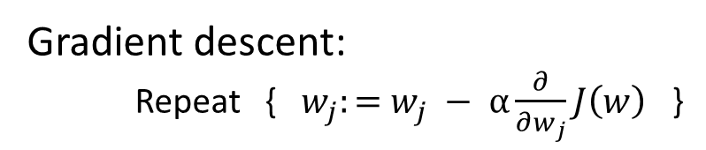
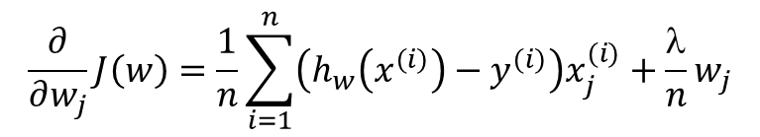
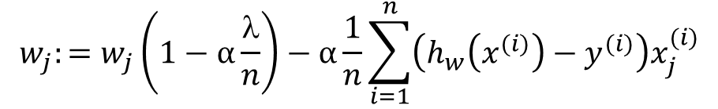
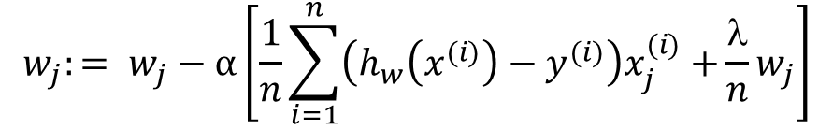
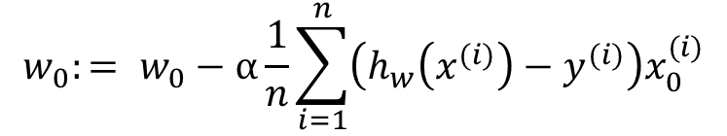
Gradient descent of Regularized linear regression
Gradient descent:
Repeat {${ w}_{j}:=$ $w_{j} − α\frac{∂}{∂w_{j}}J\left(w\right)$ }
(simultaneously update for every j = 0,1,…,d)
$$\frac{∂}{∂w_{j}}J\left(w\right)=\frac{1}{n}\sum_{i=1}^{n}{\left(h_{w}\left(x^{(i)}\right)−y^{(i)}\right)x_{j}^{(i)}}+\frac{λ}{n}w_{j}$$
$$w_{0}:= w_{0}−α\frac{1}{n}\sum_{i=1}^{n}{\left(h_{w}\left(x^{(i)}\right)−y^{(i)}\right)x_{0}^{(i)}}$$
$$w_{j}:= w_{j}−α\left[\frac{1}{n}\sum_{i=1}^{n}{\left(h_{w}\left(x^{(i)}\right)−y^{(i)}\right)x_{j}^{(i)}+}\frac{λ}{n}w_{j}\right]$$
for case j=0, there is no
regularization term included
$$w_{j}:=w_{j}\left(1−α\frac{λ}{n}\right)−α\frac{1}{n}\sum_{i=1}^{n}{\left(h_{w}\left(x^{(i)}\right)−y^{(i)}\right)x_{j}^{(i)}}$$
j = 1,…,d

Slide 12
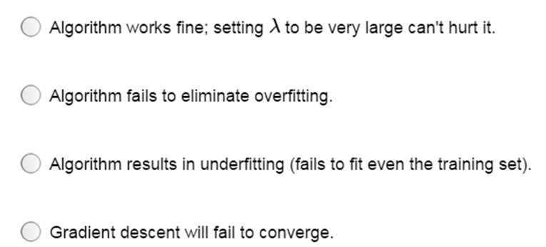
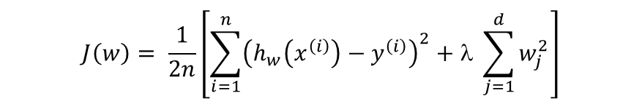
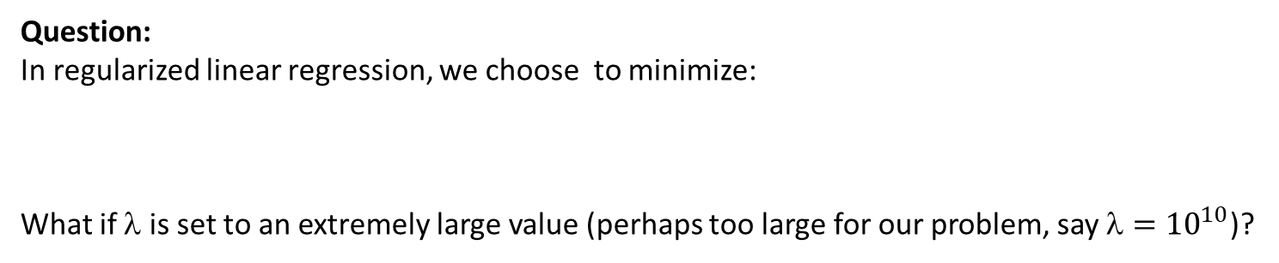
Question:
In regularized linear regression, we choose to minimize:
What if $$ is set to an extremely large value (perhaps too large for our problem, say ${=10}^{10}$)?
$$J\left(w\right)= \frac{1}{2n}\left[\sum_{i=1}^{n}{{\left(h_{w}\left(x^{\left(i\right)}\right)−y^{\left(i\right)}\right)}^{2}}+λ \sum_{j=1}^{d}{w_{j}^{2}}\right]$$

Slide 13
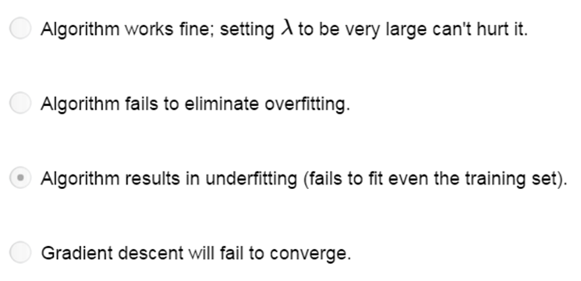
Question:
In regularized linear regression, we choose to minimize:
What if $$ is set to an extremely large value (perhaps too large for our problem, say ${=10}^{10}$)?
$$J\left(w\right)= \frac{1}{2n}\left[\sum_{i=1}^{n}{{\left(h_{w}\left(x^{\left(i\right)}\right)−y^{\left(i\right)}\right)}^{2}}+λ \sum_{j=1}^{d}{w_{j}^{2}}\right]$$

Slide 14
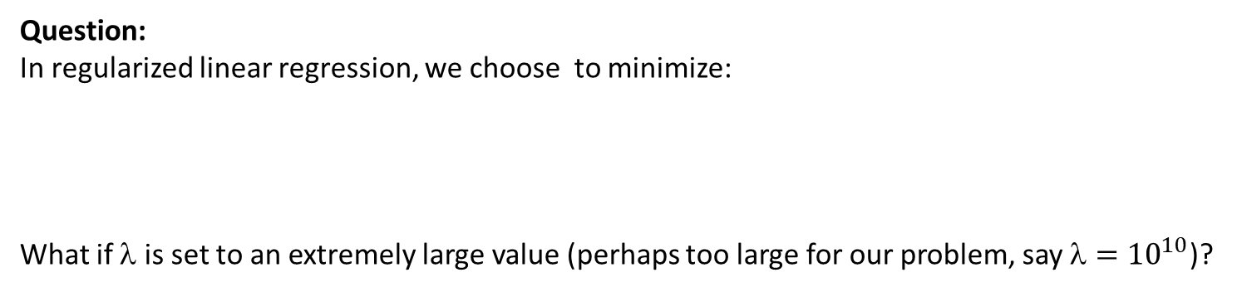

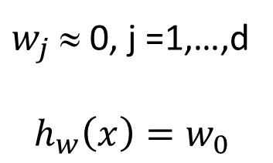
Question:
In regularized linear regression, we choose to minimize:
What if $$ is set to an extremely large value (perhaps too large for our problem, say ${=10}^{10}$)?
$$J\left(w\right)= \frac{1}{2n}\left[\sum_{i=1}^{n}{{\left(h_{w}\left(x^{\left(i\right)}\right)−y^{\left(i\right)}\right)}^{2}}+λ \sum_{j=1}^{d}{w_{j}^{2}}\right]$$
$w_{j}$ ≈ 0, j =1,…,d
$$h_{w}\left(x\right)=w_{0}$$
“Underfit”
$$h_{w}\left(x\right)=σ\left(\begin{aligned}w_{0}+w_{1}x_{1}+w_{2}x_{2}+ \\ +{w_{3}x}_{1}^{2}+{w_{4}x}_{2}^{2}+w_{5}x_{1}x_{2}+…\end{aligned}\right)$$

Slide 15
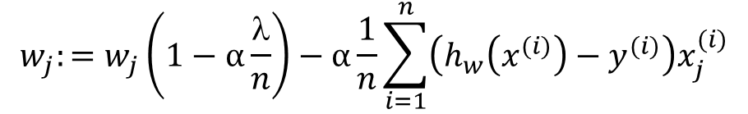
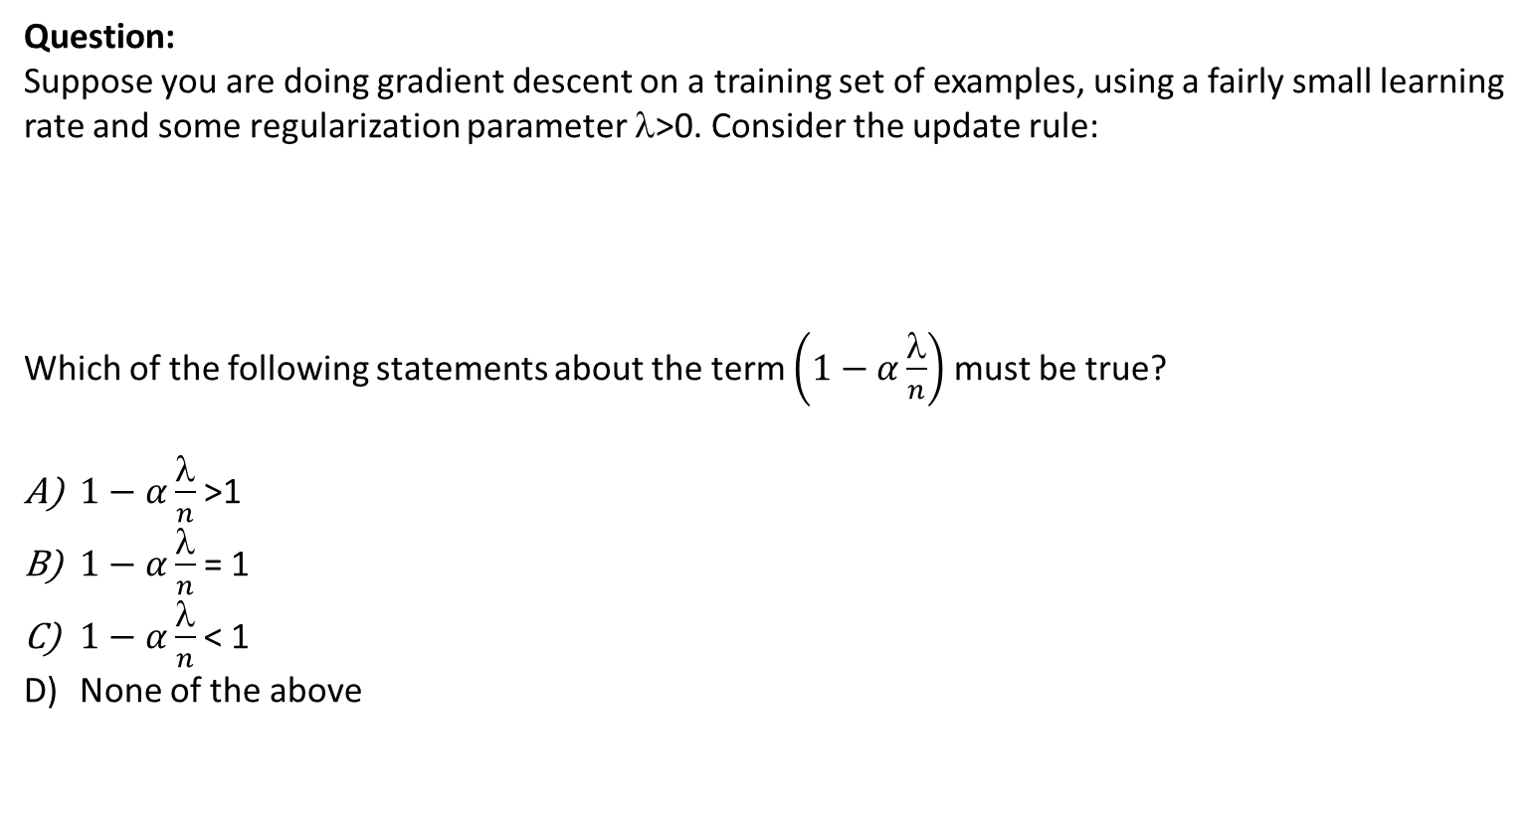
Question:
Suppose you are doing gradient descent on a training set of examples, using a fairly small learning rate and some regularization parameter $$>0. Consider the update rule:
Which of the following statements about the term $\left(1−α\frac{λ}{n}\right)$ must be true?
$1−α\frac{λ}{n}$ >1
$1−α\frac{λ}{n}$ = 1
$1−α\frac{λ}{n}$ < 1
None of the above
$$w_{j}:=w_{j}\left(1−α\frac{λ}{n}\right)−α\frac{1}{n}\sum_{i=1}^{n}{\left(h_{w}\left(x^{(i)}\right)−y^{(i)}\right)x_{j}^{(i)}}$$

Slide 16
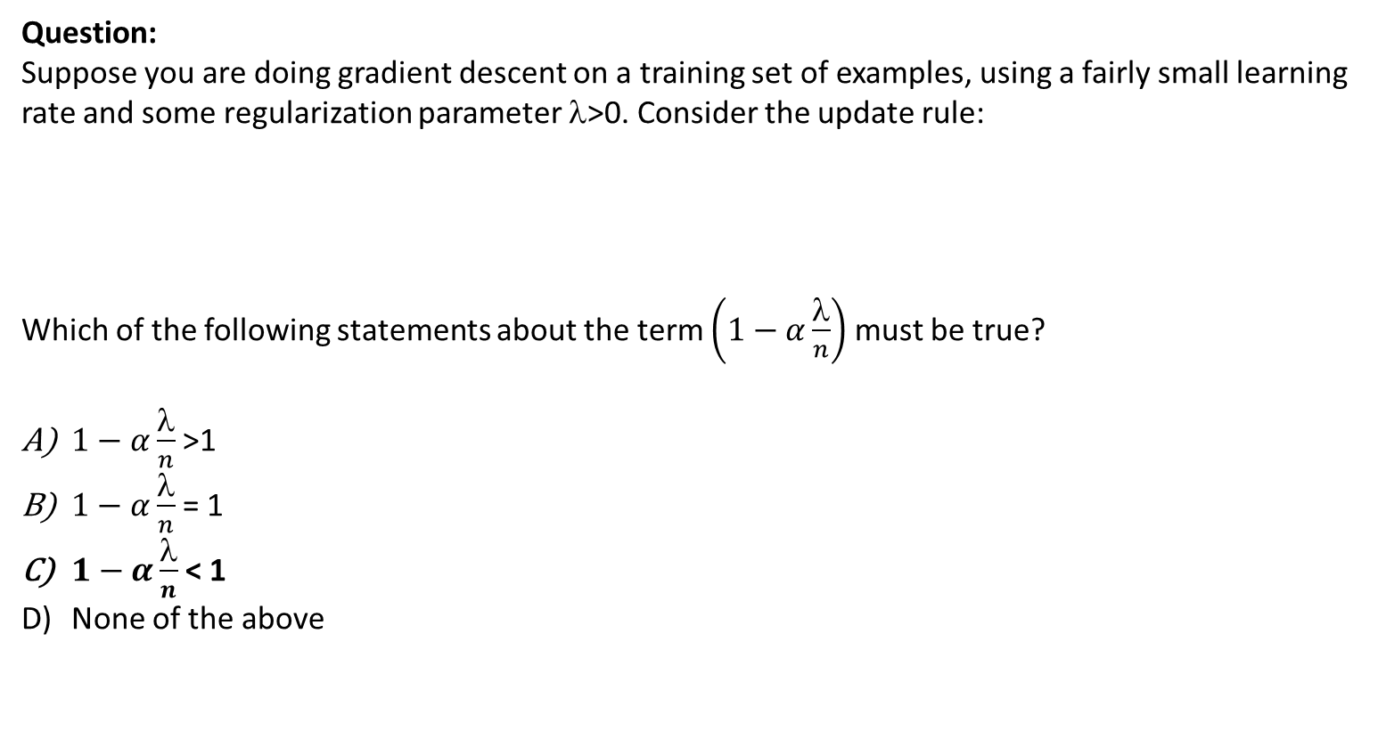
Question:
Suppose you are doing gradient descent on a training set of examples, using a fairly small learning rate and some regularization parameter $$>0. Consider the update rule:
Which of the following statements about the term $\left(1−α\frac{λ}{n}\right)$ must be true?
$1−α\frac{λ}{n}$ >1
$1−α\frac{λ}{n}$ = 1
$1−α\frac{λ}{n}$ < 1
None of the above
$$w_{j}:=w_{j}\left(1−α\frac{λ}{n}\right)−α\frac{1}{n}\sum_{i=1}^{n}{\left(h_{w}\left(x^{(i)}\right)−y^{(i)}\right)x_{j}^{(i)}}$$

Slide 17
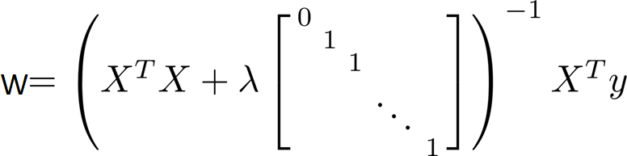
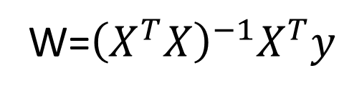
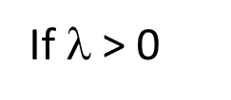
Regularization for Normal Equation
W=${\left(X^{T}X\right)}^{−1}X^{T}y$
If $n≤d$ (#examples $≤$ #features) then $X^{T}X$ non-invertible (singular)
If $$ > 0
invertible

Slide 18
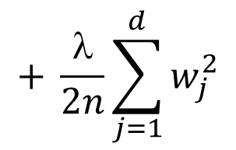
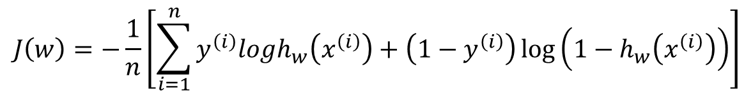
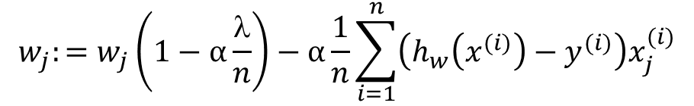
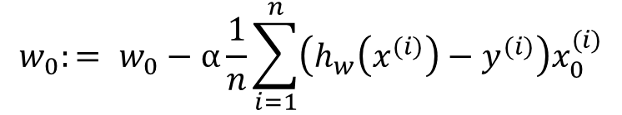
Regularized logistic regression.
x₂
Cost function:
$$J\left(w\right)=−\frac{1}{n}\left[\sum_{i=1}^{n}{y^{\left(i\right)}logh_{w}\left(x^{\left(i\right)}\right)}+\left(1−y^{\left(i\right)}\right)\log\left(1−h_{w}\left(x^{\left(i\right)}\right)\right)\right]$$
$$+ \frac{λ}{2n}\sum_{j=1}^{d}{w_{j}^{2}}$$
x₁
Gradient descent:
Repeat {
(simultaneously update
for every j = 0, 1,…,d)
$$w_{0}:= w_{0}−α\frac{1}{n}\sum_{i=1}^{n}{\left(h_{w}\left(x^{(i)}\right)−y^{(i)}\right)x_{0}^{(i)}}$$
$$w_{j}:=w_{j}\left(1−α\frac{λ}{n}\right)−α\frac{1}{n}\sum_{i=1}^{n}{\left(h_{w}\left(x^{(i)}\right)−y^{(i)}\right)x_{j}^{(i)}}$$
j = 1,…,d
}

Slide 19
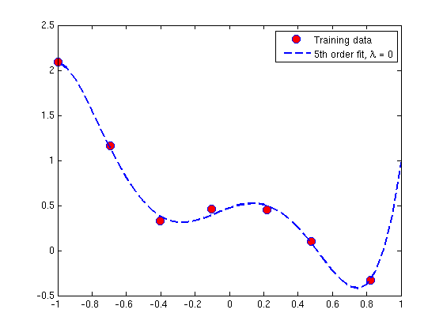
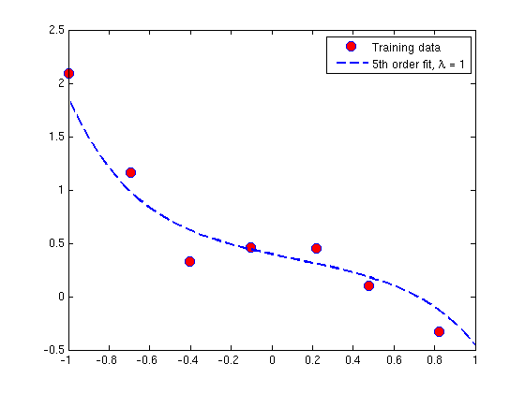
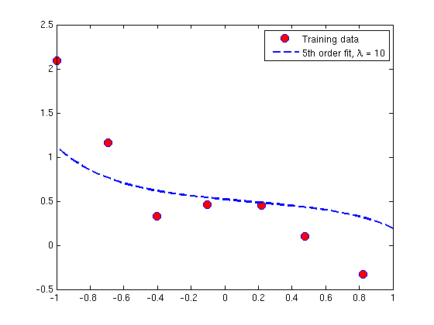
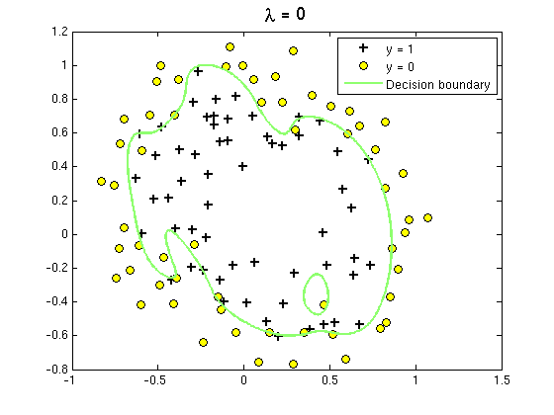
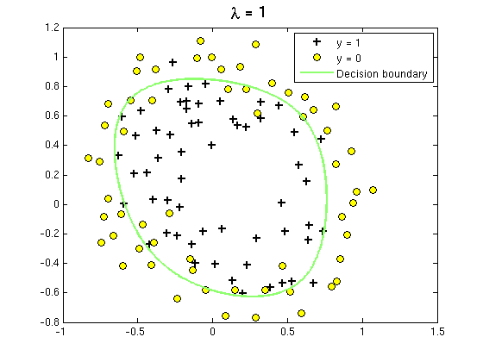
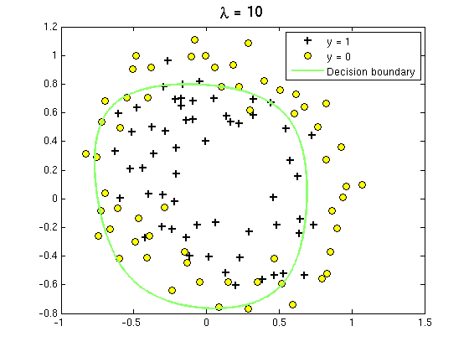
Regularization for Regression problem
Regularization for Classification problem
http://openclassroom.stanford.edu/MainFolder/DocumentPage.php?course=MachineLearning&doc=exercises/ex5/ex5.html

Slide 20
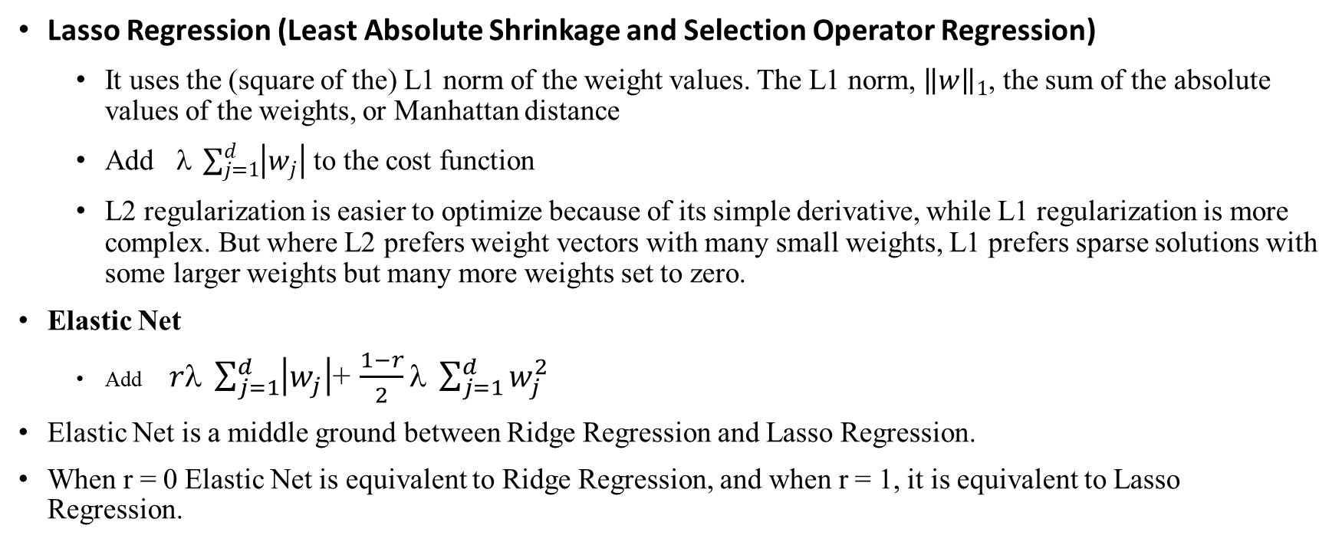
Regularization (other)
Lasso Regression (Least Absolute Shrinkage and Selection Operator Regression)
It uses the (square of the) L1 norm of the weight values. The L1 norm, ${\left\|w\right\|}_{1}$, the sum of the absolute values of the weights, or Manhattan distance
Add $ \sum_{j=1}^{d}{\left|w_{j}\right|}$ to the cost function
L2 regularization is easier to optimize because of its simple derivative, while L1 regularization is more complex. But where L2 prefers weight vectors with many small weights, L1 prefers sparse solutions with some larger weights but many more weights set to zero.
Elastic Net
Add$rλ \sum_{j=1}^{d}{\left|w_{j}\right|}$+ $\frac{1−r}{2}λ \sum_{j=1}^{d}{w_{j}^{2}}$
Elastic Net is a middle ground between Ridge Regression and Lasso Regression.
When r = 0 Elastic Net is equivalent to Ridge Regression, and when r = 1, it is equivalent to Lasso Regression.

Slide 21
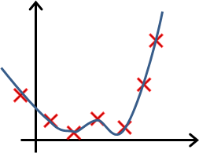
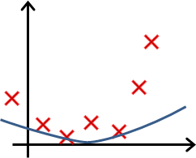
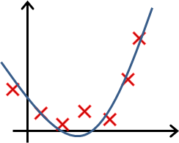
Question
In which one of the following figures do you think the hypothesis has overfit the training set?

Slide 22
Answer
Correct (The hypothesis follows the data points very closely and is highly complicated, indicating that it is overfitting the training set.)

Slide 23
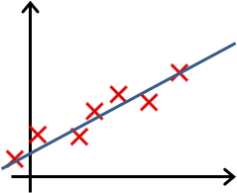
Question
In which one of the following figures do you think the hypothesis has underfit the training set?

Slide 24
Answer
Correct
The hypothesis does not predict many data points well, and is thus underfitting the training set.

Slide 25
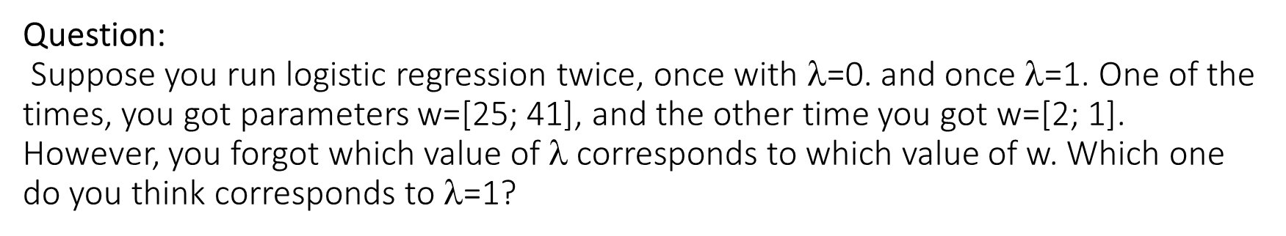
Question: Suppose you run logistic regression twice, once with $$=0. and once $$=1. One of the times, you got parameters w=[25; 41], and the other time you got w=[2; 1]. However, you forgot which value of $$ corresponds to which value of w. Which one do you think corresponds to $$=1?
A) w=[25; 41]
B) w=[2 ;1]
When $$ is set to 1, we use regularization to penalize large values of w. Thus, the parameters, w, obtained will in general have smaller values.

Slide 26
Reading material.
Aurelien Geron. Hands-On Machine Learning üith Scikit-Learn and TensorFlow.
Chapter 4. Training Models.

